Slide 1
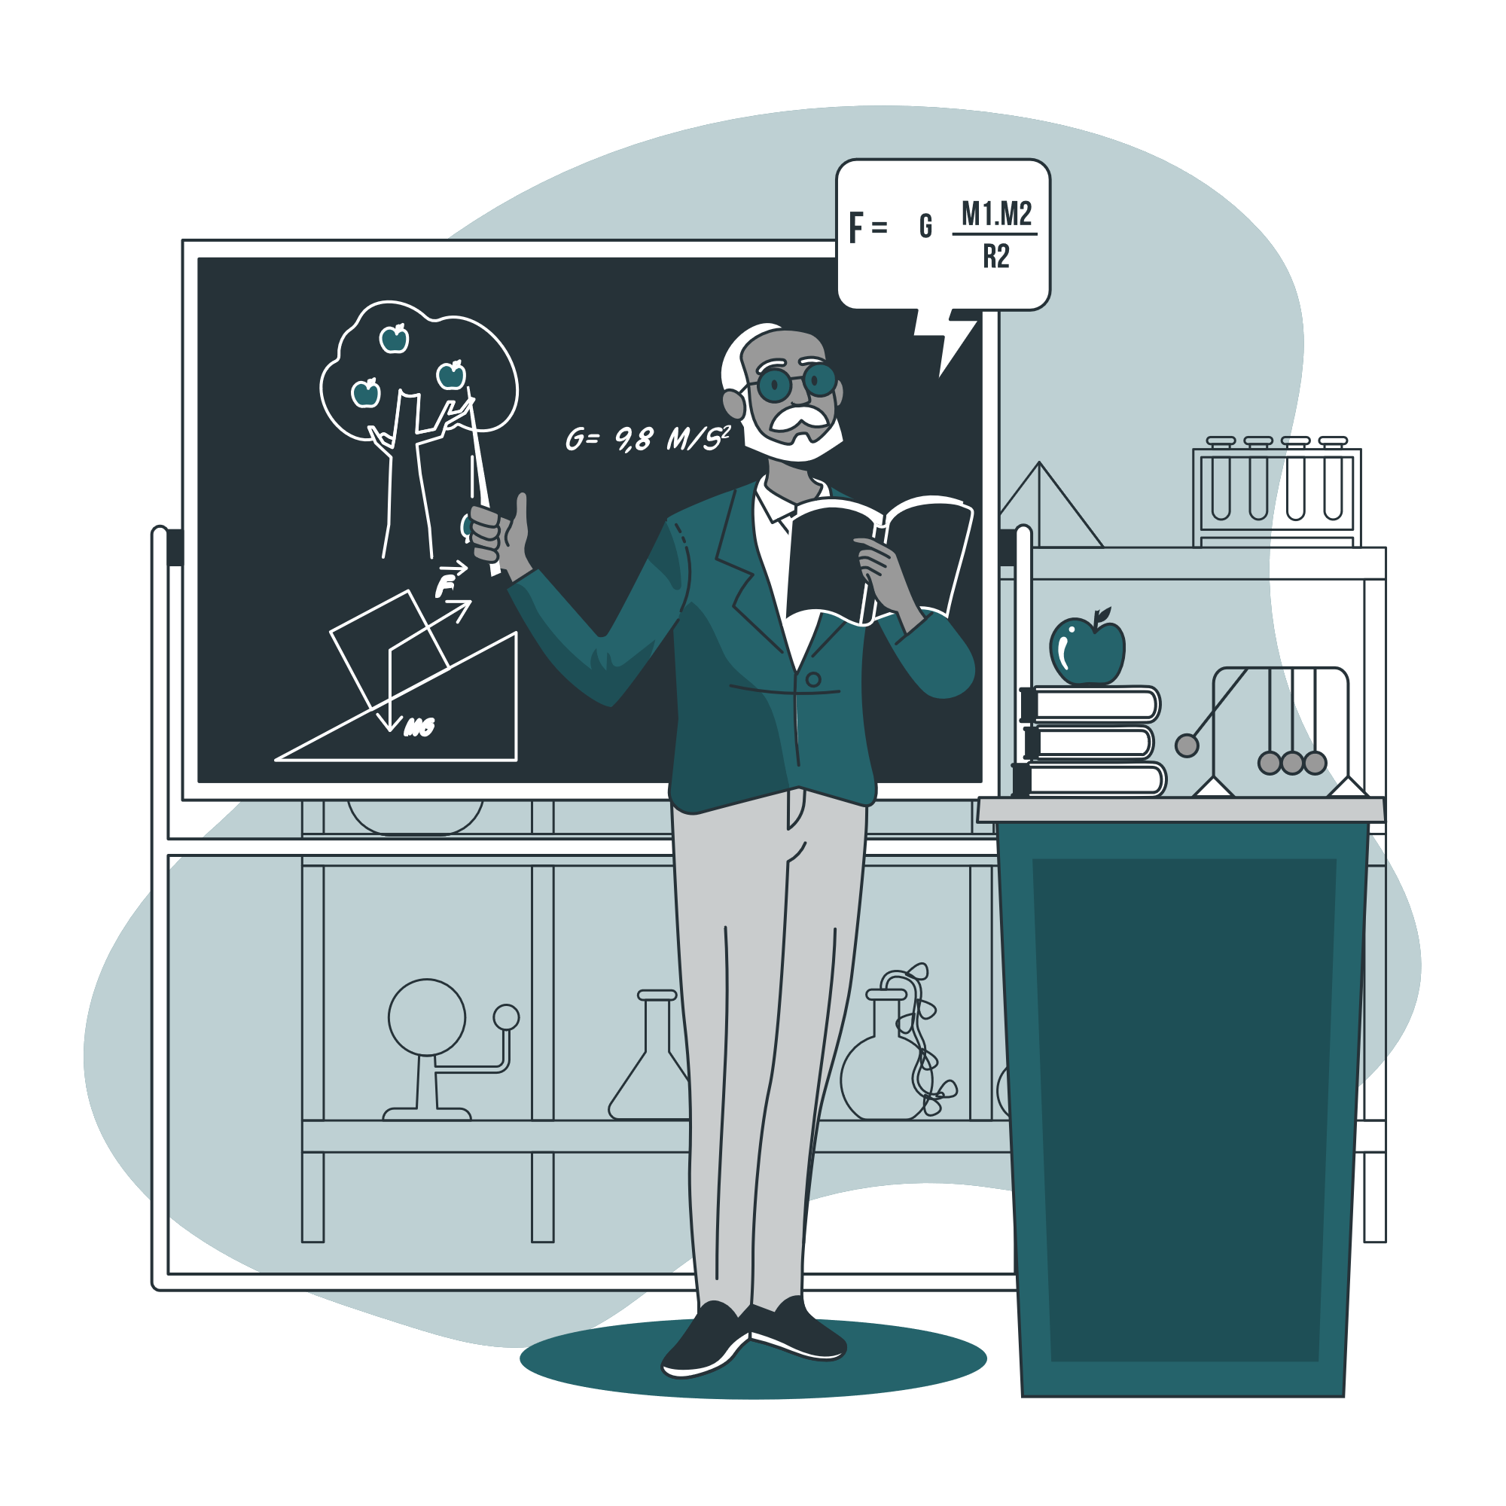
Discrete Math Chapter 2
Proofs and Number Theory

Slide 2
Chapter 2 Overview
2-1 Intro to Proofs Techniques
2-2 Inductions
2-3 Euclidean Algorithm
2-4 Introduction to Number Theory

Slide 3
Notes of Chapter 2
Chapter 2 is based on the logical rules we learn in chapter 1; make sure that you didn’t skip chapter 1-1.

Slide 4

2-1 Introduction to Proofs Techniques

Slide 5
Mathematical Proofs
In mathematical proofs, we have to show that the stated assumptions logically guarantee the conclusion. In 2-1, we will discuss the following common ways of mathematical proofs:
Find Counterexample (used when proving something is wrong)
Exhaustive Proof
Direct Proof
Contraposition
Contradiction

Slide 6
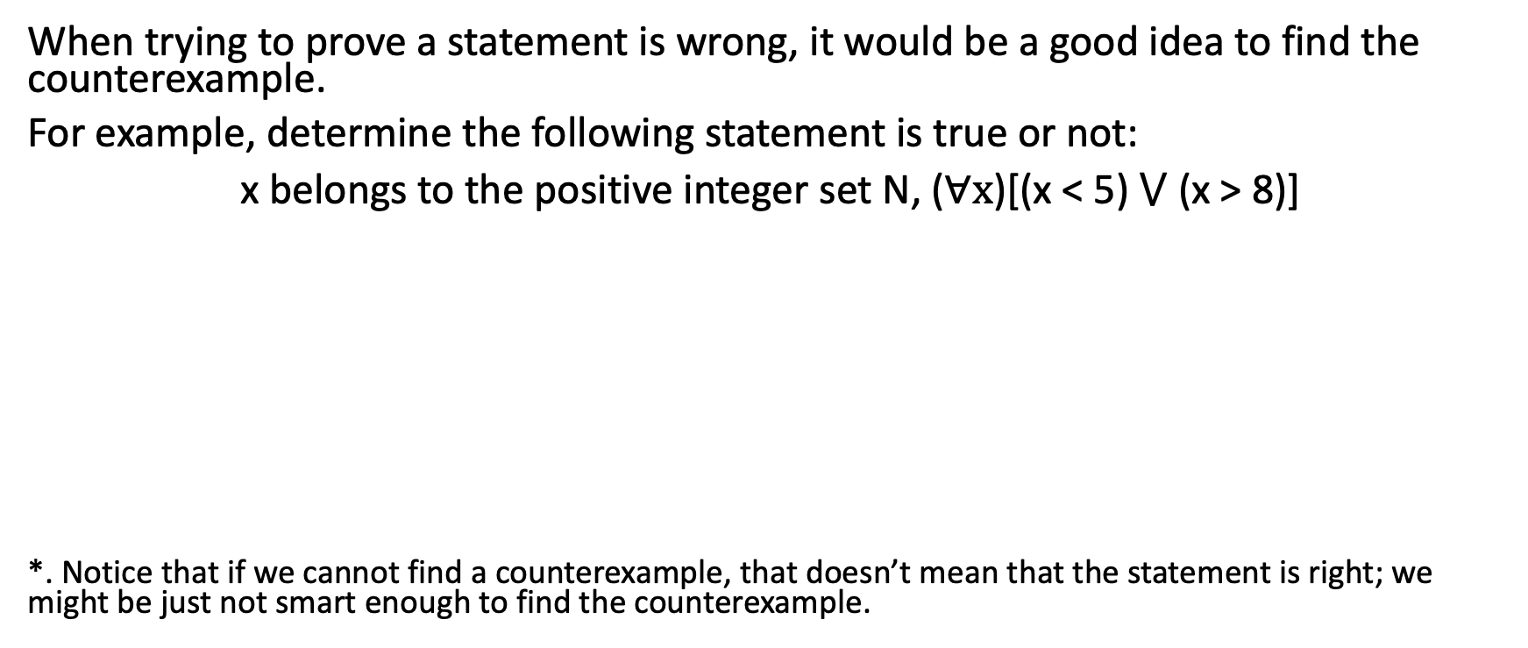
Find Counterexample
When trying to prove a statement is wrong, it would be a good idea to find the counterexample.
For example, determine the following statement is true or not:
x belongs to the positive integer set N, ($∀x$)[(x < 5) $⋁$ (x > 8)]
*. Notice that if we cannot find a counterexample, that doesn’t mean that the statement is right; we might be just not smart enough to find the counterexample.

Slide 7
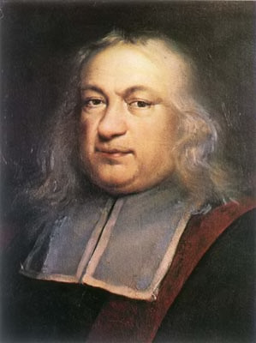
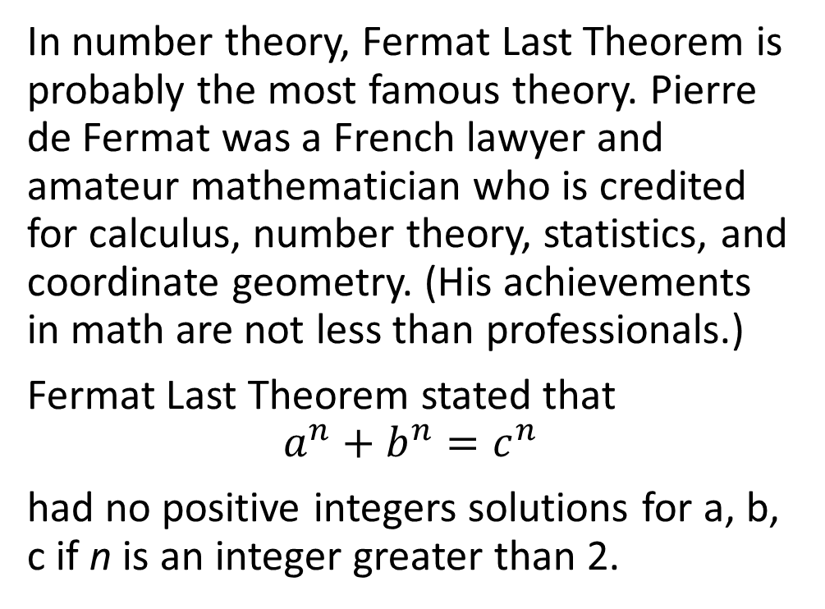
Fermat Last Theorem
In number theory, Fermat Last Theorem is probably the most famous theory. Pierre de Fermat was a French lawyer and amateur mathematician who is credited for calculus, number theory, statistics, and coordinate geometry. (His achievements in math are not less than professionals.)
Fermat Last Theorem stated that
$$a^{n}+b^{n}=c^{n}$$
had no positive integers solutions for a, b, c if n is an integer greater than 2.

Slide 8
Fermat Last Theorem
Pierre de Fermat wrote down this claim (Fermat Last Theorem)in 1637 inside his copy of a book called Arithmetica. He said "I have a proof of this theorem, but there is not enough space in this margin". However, no correct proof was found for 357 years.
In the latter half of the 20th century, computational methods were used to find counterexamples of this claim. From 1950s to 1990s, Fermat’s claim had been proved for all primes less than four million. However, unable to find a counterexample doesn’t mean that this claim is right.

Slide 9
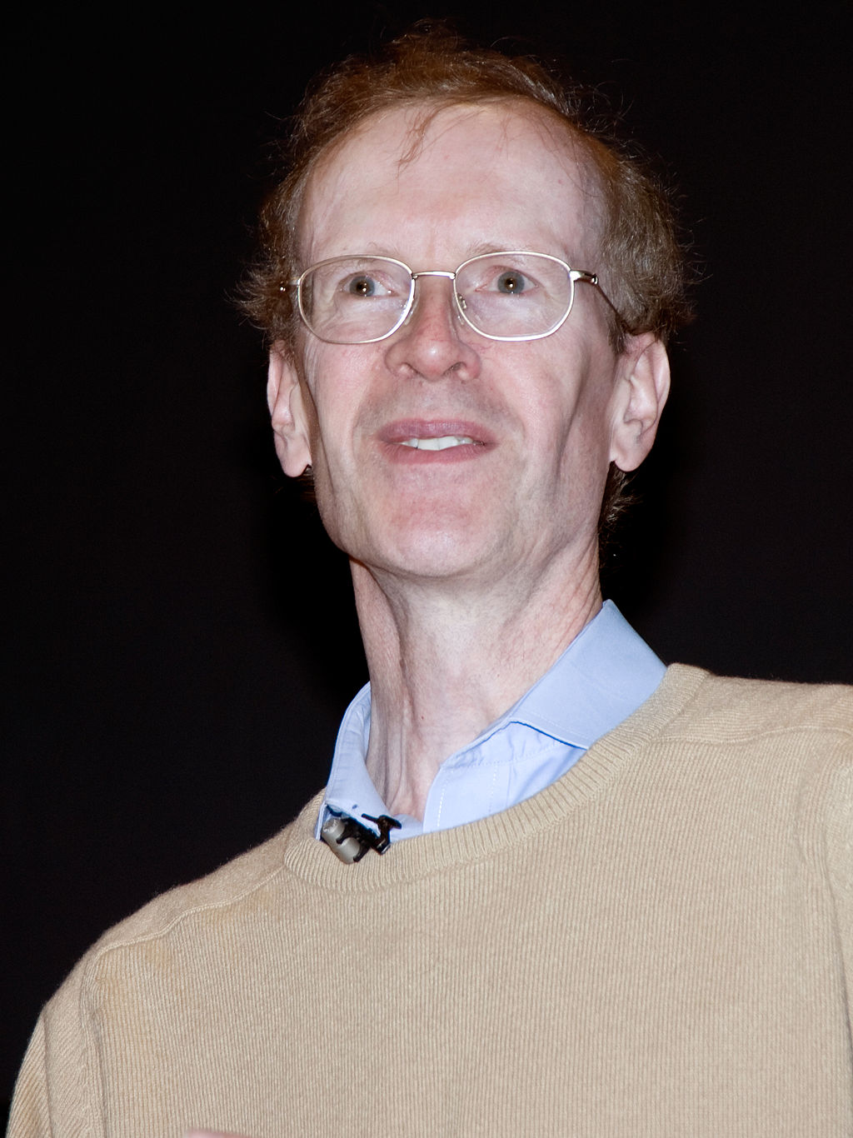
Fermat Last Theorem
In 1995, Fermat Last Theorem was proven by an English mathematician Andrew Wiles, Professor at the University of Oxford.
However, Andrew Wiles used many techniques that were not found yet in Fermat’s time; therefore, people doubt how Fermat proved this theorem.

Slide 10
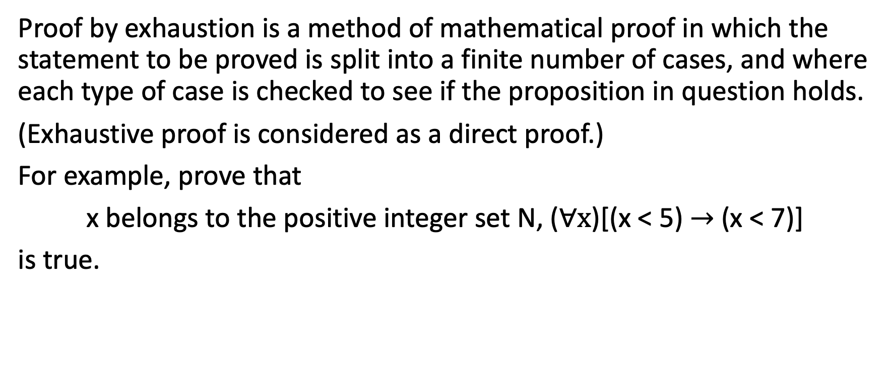
Exhaustive Proof
Proof by exhaustion is a method of mathematical proof in which the statement to be proved is split into a finite number of cases, and where each type of case is checked to see if the proposition in question holds.
(Exhaustive proof is considered as a direct proof.)
For example, prove that
x belongs to the positive integer set N, ($∀x$)[(x < 5) $→$ (x < 7)]
is true.

Slide 11
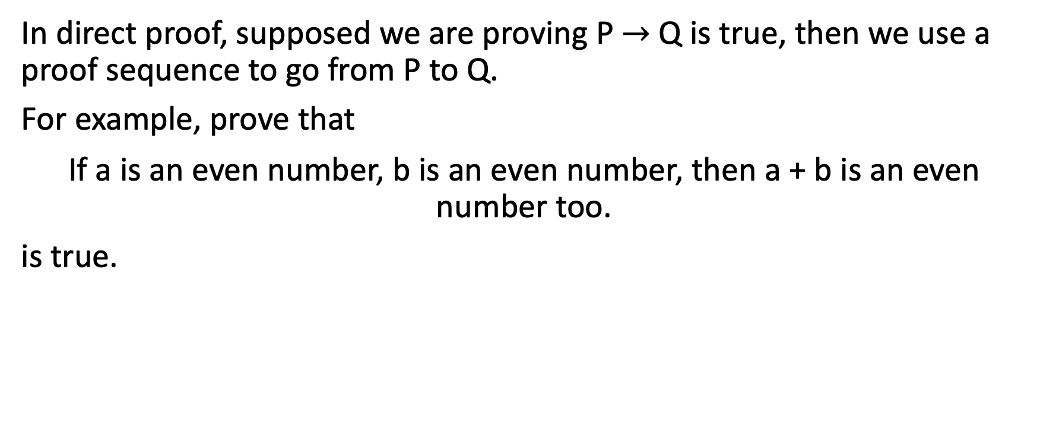
Direct Proof
In direct proof, supposed we are proving P $→$ Q is true, then we use a proof sequence to go from P to Q.
For example, prove that
If a is an even number, b is an even number, then a + b is an even number too.
is true.

Slide 12
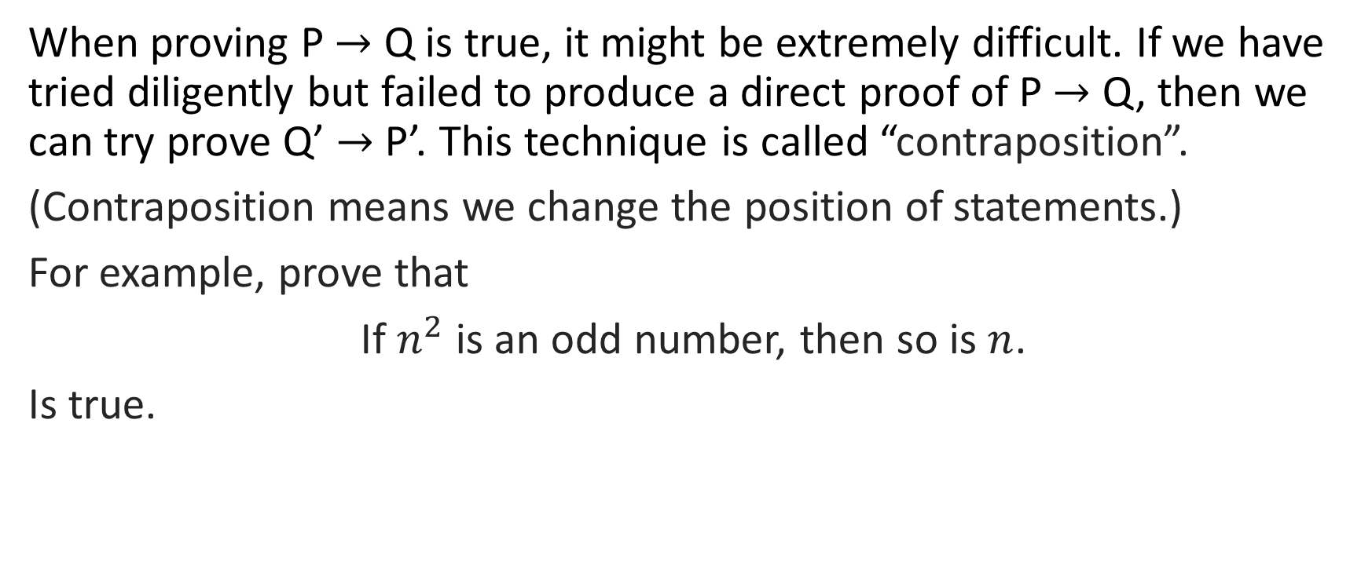
Contraposition
When proving P $→$ Q is true, it might be extremely difficult. If we have tried diligently but failed to produce a direct proof of P $→$ Q, then we can try prove Q’ $→$ P’. This technique is called “contraposition”.
(Contraposition means we change the position of statements.)
For example, prove that
If $n^{2}$ is an odd number, then so is $n$.
Is true.

Slide 13
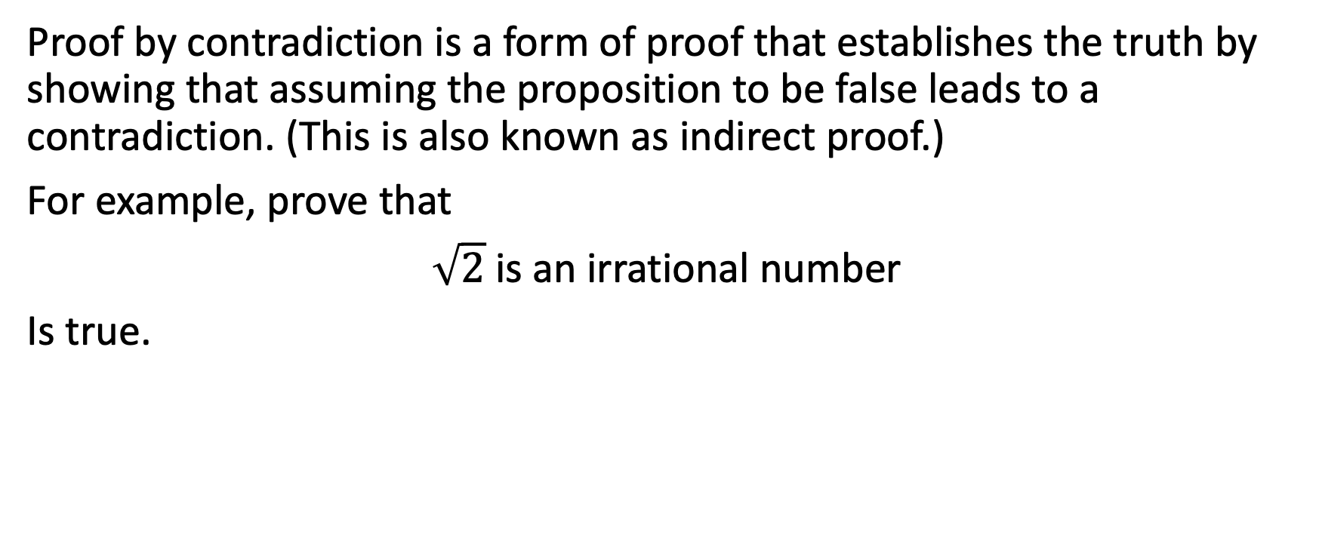
Contradiction
Proof by contradiction is a form of proof that establishes the truth by showing that assuming the proposition to be false leads to a contradiction. (This is also known as indirect proof.)
For example, prove that
$\sqrt{2}$ is an irrational number
Is true.

Slide 14

2-2 Mathematical Induction

Slide 15
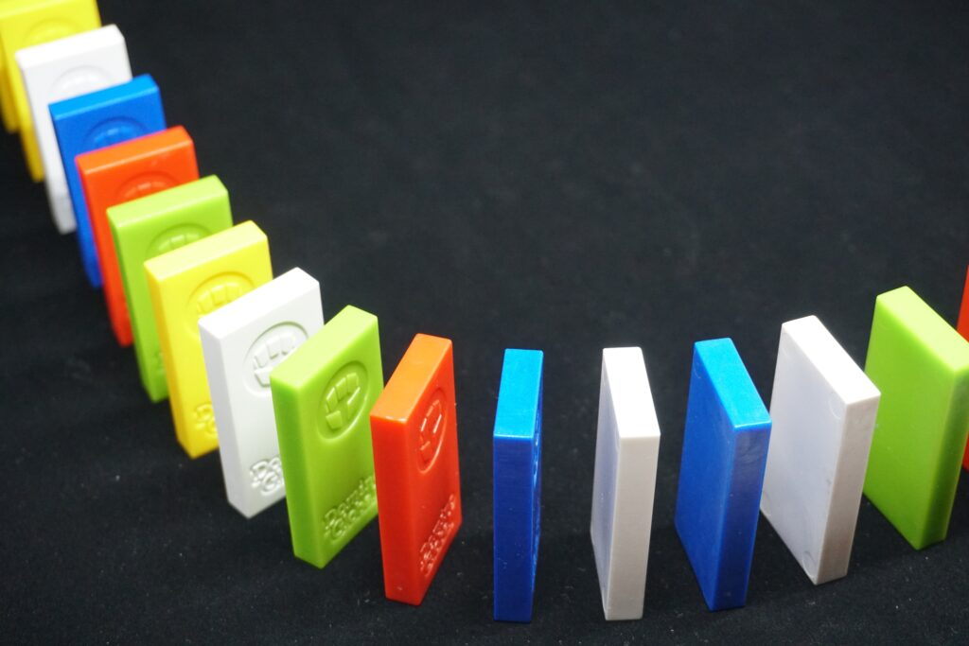
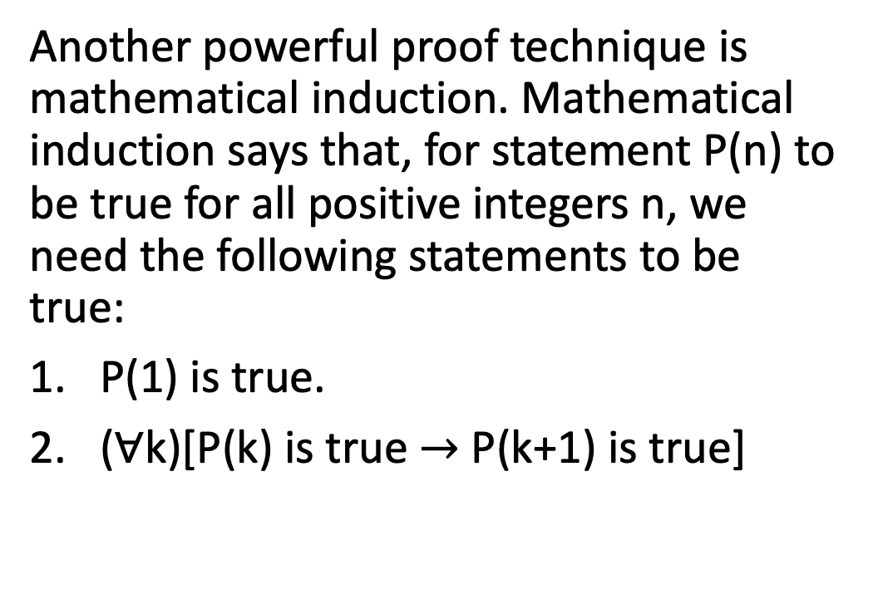
First Pinciple of Mathematical Induction
Another powerful proof technique is mathematical induction. Mathematical induction says that, for statement P(n) to be true for all positive integers n, we need the following statements to be true:
P(1) is true.
($∀$k)[P(k) is true $→$ P(k+1) is true]

Slide 16
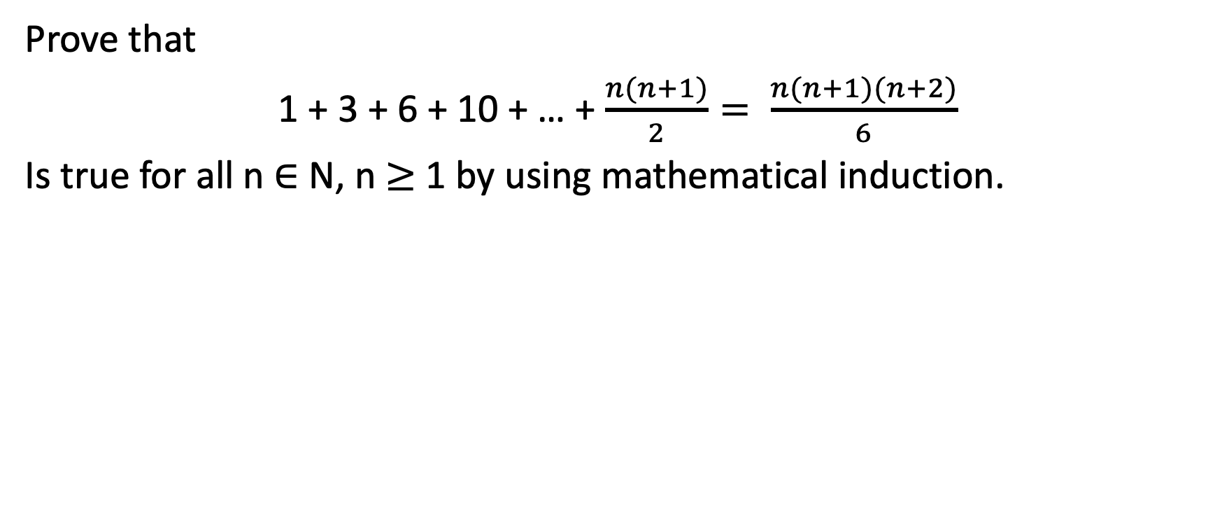
Example 2-2-1
Prove that
1 + 3 + 6 + 10 + … + $\frac{n(n+1)}{2}= \frac{n(n+1)(n+2)}{6}$
Is true for all n $∈$ N, n $≥$ 1 by using mathematical induction.

Slide 17
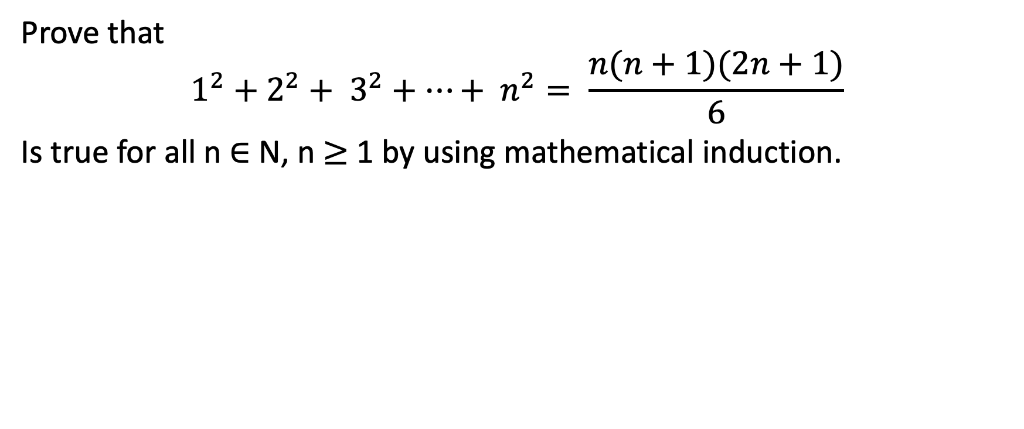
Example 2-2-2
Prove that
$$1^{2}+2^{2}+ 3^{2}+…+ n^{2}= \frac{n(n+1)(2n+1)}{6}$$
Is true for all n $∈$ N, n $≥$ 1 by using mathematical induction.

Slide 18
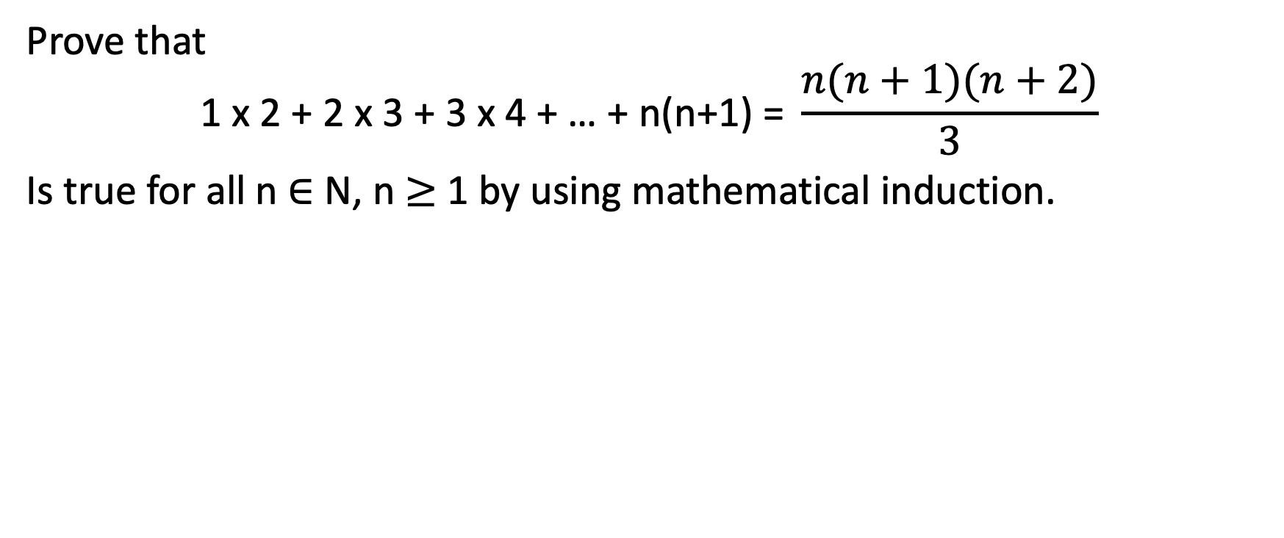
Example 2-2-3
Prove that
$$\text{1} \text{x}\text{ 2 + 2 }\text{x}\text{ 3 + 3 }\text{x}\text{ 4 + … + }\text{n}\text{(}\text{n}\text{+1) = }\frac{n(n+1)(n+2)}{3}$$
Is true for all n $∈$ N, n $≥$ 1 by using mathematical induction.

Slide 19
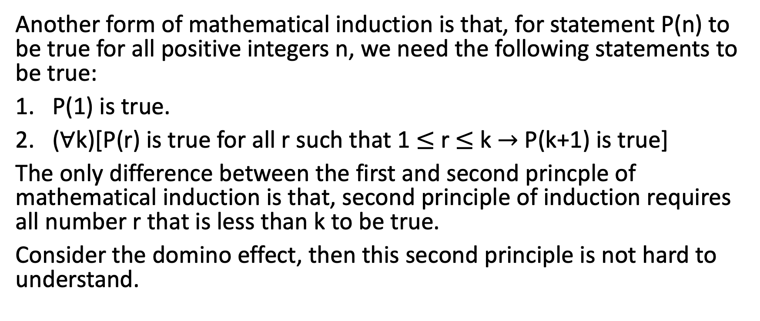
Second Principle of Mathematical Induction
Another form of mathematical induction is that, for statement P(n) to be true for all positive integers n, we need the following statements to be true:
P(1) is true.
($∀$k)[P(r) is true for all r such that 1 $≤$ r $≤$ k $→$ P(k+1) is true]
The only difference between the first and second princple of mathematical induction is that, second principle of induction requires all number r that is less than k to be true.
Consider the domino effect, then this second principle is not hard to understand.

Slide 20
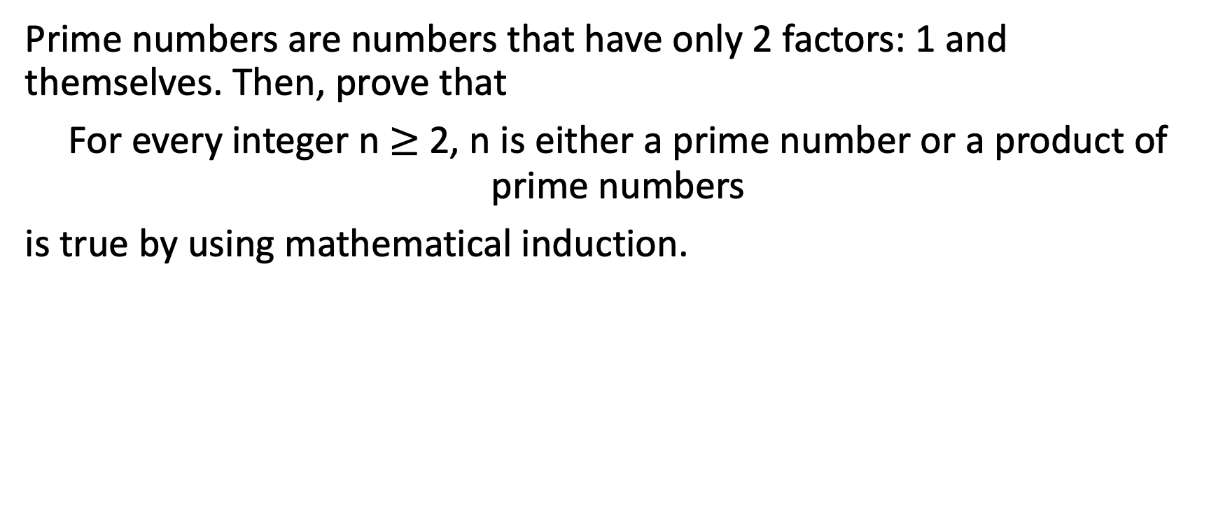
Example 2-2-4
Prime numbers are numbers that have only 2 factors: 1 and themselves. Then, prove that
For every integer n $≥$ 2, n is either a prime number or a product of prime numbers
is true by using mathematical induction.

Slide 21

2-3 Euclidean Algorithm

Slide 22
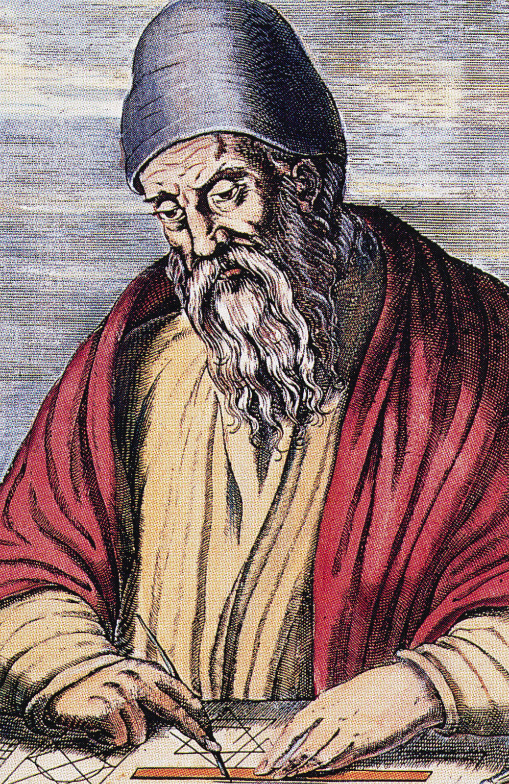
Euclidean Algorithm
Euclidean algorithm was described by the Greek mathematician Euclid over 2300 years ago (although it might have been known even earlier.)
This algorithm finds the greatest common divisor among any two integers a and b. GCD of a and b is denoted as gcd(a, b); for example:
gcd(420, 66) = 6.

Slide 23
Find GCD by hands
Let’s recall how we get gcd of 2 numbers by hands. This is elementary school level skill.

Slide 24

Find GCD by Algorithm
Let’s learn how to find gcd by designing a good algorithm.

Slide 25
Prime Number
A prime number (or a prime) is a natural number greater than 1 that is not a product of two smaller natural numbers. A natural number greater than 1 that is not prime is called a composite number.
Why do we care about prime numbers? Well, it’s a big topic in number theory, since we are not familiar enough with primes. Another important reason is Cryptography. Modern Cryptography algorithms, such as RSA algorithm, rely on the unfamiliarity of prime numbers for human.
For example, to find the prime factors of a large integer is hard. We don’t have any efficient algorithm for this task; human can just try brute force solution.

Slide 26
Coding Lesson
Write a function called isPrime() that takes a positive integer as an input and returns a Boolean value that indicates whether the input is a prime number.

Slide 27
Coding Lesson
Supposed that we have a list of prime numbers. The first 6 numbers on the list are 2, 3, 5, 7,11, 13. What is the 999th number in the prime number list?
Write a function called nthPrime() that takes a positive integer as input and returns the nth value in the prime number list.

Slide 28

2-4 Introduction to Number Theory

Slide 29
Number Theory
Number theory is a branch of pure mathematics devoted primarily to the study of the integers and integer-valued functions. Before number theory and prime numbers were introduced and used in cryptography, it was a pure fun topic.
Chapter 2-4 is just an introduction to number theory. The full number theory and cryptography course can be found on Udemy.

Slide 30
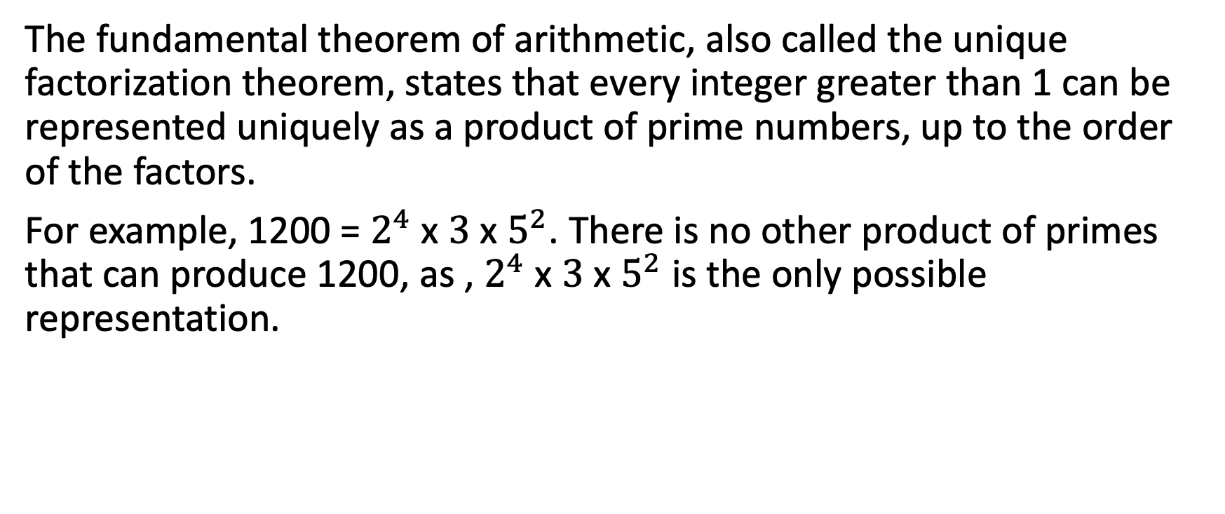
The Fundamental Theorem of Arithmetic
The fundamental theorem of arithmetic, also called the unique factorization theorem, states that every integer greater than 1 can be represented uniquely as a product of prime numbers, up to the order of the factors.
For example, 1200 = $2^{4}$ x $3$ x $5^{2}$. There is no other product of primes that can produce 1200, as , $2^{4}$ x $3$ x $5^{2}$ is the only possible representation.

Slide 31
Improved Way of Prime Checking – Part I
According to The Fundamental Theorem of Arithmetic, we know that all numbers can uniquely be presented as a product of prime numbers. Therefore, a faster way to check if a number n is prime will be – divide n by all primes that is less than n; if n is not divisible by all primes that are less than n, then n must be a prime number.
For example, to check if 101 is a prime number, then we divide 101 by 2, 3, 5, 7, 11, 13, 17, 19, 23, 29, 31, 37, 41, 43, 47, 53, 59, 61, 67, 71, 73, 79, 83, 89, 97; since 101 is not divisible by any of them, therefore, 101 is a prime number.

Slide 32
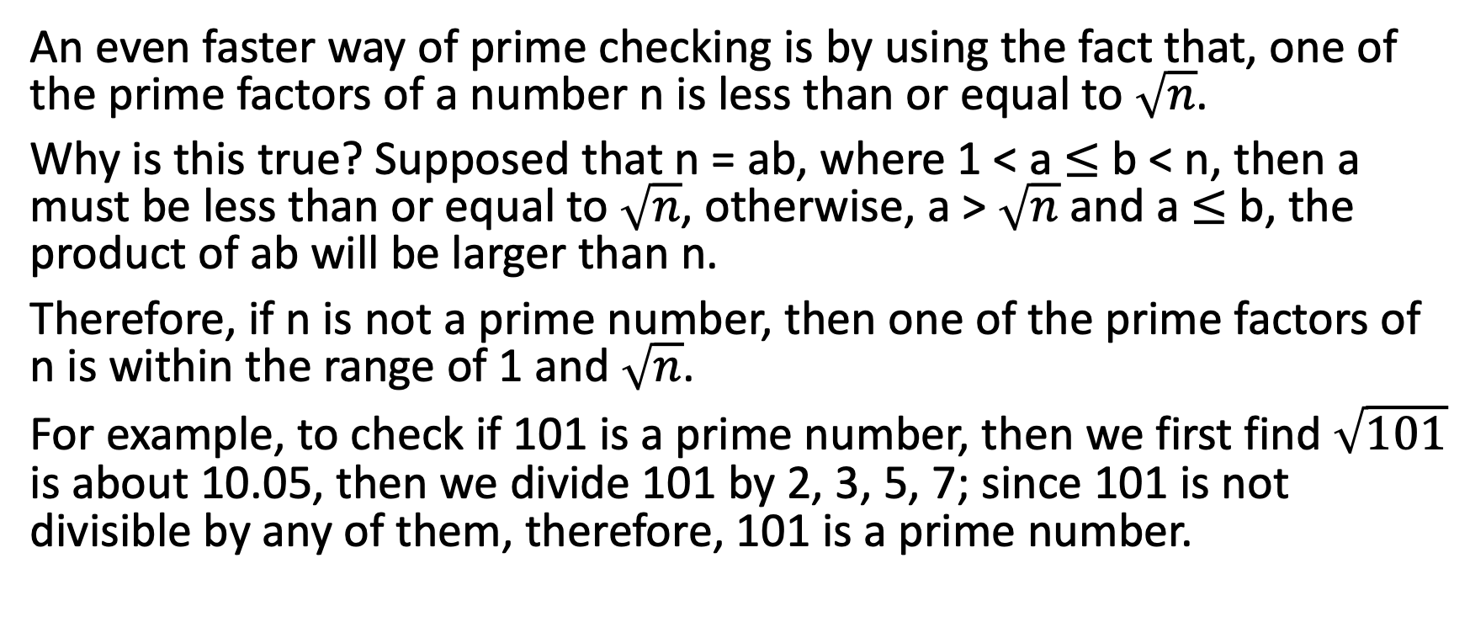
Improved Way of Prime Checking – Part II
An even faster way of prime checking is by using the fact that, one of the prime factors of a number n is less than or equal to $\sqrt{n}$.
Why is this true? Supposed that n = ab, where 1 < a $≤$ b < n, then a must be less than or equal to $\sqrt{n}$, otherwise, a > $\sqrt{n}$and a $≤$ b, the product of ab will be larger than n.
Therefore, if n is not a prime number, then one of the prime factors of n is within the range of 1 and $\sqrt{n}$.
For example, to check if 101 is a prime number, then we first find $\sqrt{101}$ is about 10.05, then we divide 101 by 2, 3, 5, 7; since 101 is not divisible by any of them, therefore, 101 is a prime number.

Slide 33
Coding Lesson
According to The Fundamental Theorem of Arithmetic, we know that all numbers can uniquely be presented as a product of prime numbers. Write a function that takes in one positive integer as input and return the prime factorization of this integer. (Return the unique product of primes)

Slide 34
Euler's totient function
In number theory, Euler's totient function counts the positive integers up to a given integer n that are relatively prime to n. It is written using the Greek letter phi as φ(n) and may also be called Euler's phi function.
φ(2) = 1
φ(3) = 2
φ(4) = 2
φ(5) = 4
φ(6) = 2
φ(150000) = Something that we don’t know for now.

Slide 35
Example 2-4-1
Find the value of φ(120).

Slide 36
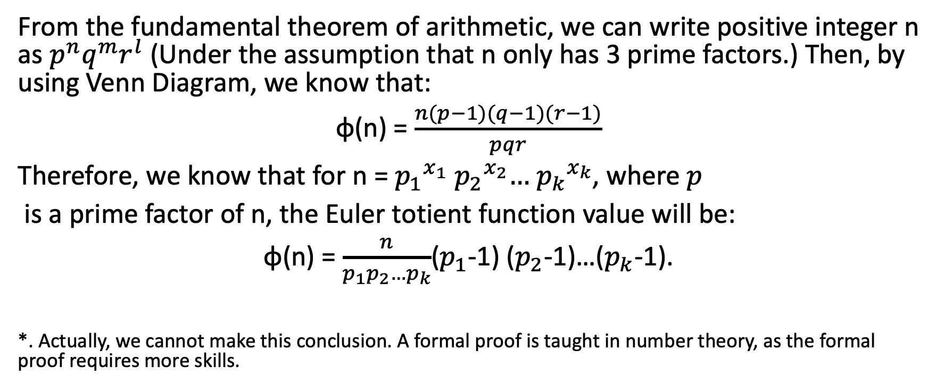
Formula of Euler's totient function
From the fundamental theorem of arithmetic, we can write positive integer n as $p^{n}q^{m}r^{l}$ (Under the assumption that n only has 3 prime factors.) Then, by using Venn Diagram, we know that:
φ(n) = $\frac{n(p−1)(q−1)(r−1)}{pqr}$
Therefore, we know that for n =${ p_{1}}^{x_{1}}{ p_{2}}^{x_{2}}…{ p_{k}}^{x_{k}}$, where $p$
is a prime factor of n, the Euler totient function value will be:
φ(n) = $\frac{n}{p_{1}p_{2}…p_{k}}$($p_{1}$-1) ($p_{2}$-1)…($p_{k}$-1).
*. Actually, we cannot make this conclusion. A formal proof is taught in number theory, as the formal proof requires more skills.

Slide 37
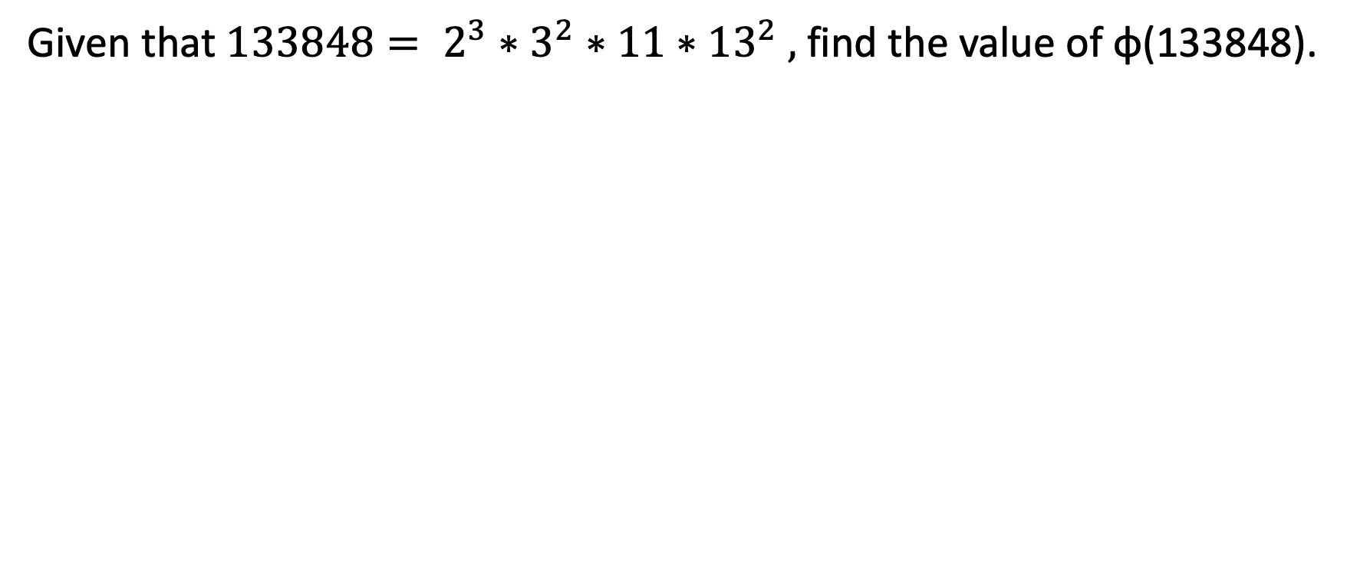
Example 2-4-2
Given that $133848= 2^{3}∗3^{2}∗11∗{13}^{2} ,$find the value of φ(133848).

Slide 38
Coding Lesson
Write a Euler’s Totient Function calculator that returns the phi function value of a given input.

